Slide 1

Project Presentation On HOSPITAL MANAGEMENT SYSTEM
SUBMITTED BY:-
DINESH KUMAR
DIPTI KUMARI
GOMATHI
MOHHAMAD IBRAHIM
Under the Guidance of POOJA MEHTA MA’AM

Slide 2
Introduction
Hospital management system is a automated computer system that helps manage the information related to health and care in a hospital. They manage the data related to all departments of healthcare such as Login ,Patient, Doctor, Appointment.

Slide 3
OBJECTIVE
The main objective of creating this application is to maintain the hospital system by adding login, patient , doctor as well as appointments. By this we can add , delete them as well. Hence this process is beneficial because now-a-days everything has become digital.

Slide 4
Technology Used
The main technologies which are being used in this project are:-
JAVA:- Java is a programming language and a platform. Java is a high level, robust, object-oriented and secure programming language.
SPRING BOOT:- Spring Boot is an open source Java-based framework used to create a micro Service.
DATA JPA:- Spring Data JPA, part of the larger Spring Data family, makes it easy to easily implement JPA based repositories.
MYSQL:- MySQL is a very popular open-source relational database management system (RDBMS).
THYMELEAF:- Thymeleaf is a Java-based library used to create a web application. It provides a good support for serving a HTML5 in web applications.

Slide 5
Hardware Software Requirement
Hardware Requirement
Processor: Intel® Core™ i3-7200U CPU @2.50GHZ 2.71GHZ
Main Memory: 4 GB RAM
HDD: 1TB
SSD: 256 GB
Software Requirement
Operating System: WINDOWS 10 HOME
Programming Language: Java (Spring Boot)
Documentation: Ms Powerpoint Presentation
Backup media: Solid state drive(SDD)

Slide 6
Annotations
Annotations are the key components. Spring Boot annotations are simple and self-explanatory. There are a large number of annotations are implemented in Spring Core. But In Spring Boot most of the annotations are enhanced and combined in simpler ones to write fewer lines of code.
Some of the annotations used in the projects are:-
@SpringBootApplication:-
@SpringBootApplication = @Configuration + @ComponentScan + @EnableAutoConfiguration. The @SpringBootApplication annotation is a combination of following three Spring annotations and provides the functionality of all three with just one line of code.
@Controller:-
@Controller annotation indicates that the annotated class is a controller.
@Autowired:-
In the spring boot, the @Autowired annotation is used in setter methods to inject the value of the class properties

Slide 7
@Entity:-
The @Entity annotation specifies that the class is an entity and is mapped to a database table.
@Id :-
The @Id annotation is inherited from javax.persistence.Id, indicating the member field below is the primary key of the current entity.
@Table ():-
@Table(), the JPA annotation is used for adding the table name in the particular MySQL database.
@GeneratedValue :-
The @GeneratedValue annotation uses two parameters, strategy, and GenerationType.

Slide 8
@GetMapping :-
@ GetMapping annotation maps HTTP GET requests onto specific handler methods. It acts as a shortcut for @RequestMapping(method = RequestMethod.
@RequestMapping :-
Request Mapping Annotation in Spring Boot @RequestMapping is a class level (also called type level) and method level annotation, it is used to process HTTP requests with specified URL patterns.
@PostMapping :-
@PostMapping is a composed annotation that acts as a shortcut for @RequestMapping (method = RequestMethod.POST).

Slide 9
About Backend
Service:-
Spring boot service component is defined as a class file that includes the @Service annotation and allows developers to add business functionalities. The annotation is used with the classes that provide these business functionalities.
Repository:-
Spring is a popular Java application framework and Spring Boot is an evolution of Spring that helps create stand-alone, production-grade Spring based applications easily. @Repository is a Spring annotation that indicates that the decorated class is a repository.

Slide 10
POJO Classes:-
The POJO class is an object class that encapsulates the Business logic. In an MVC architecture, the Controller interacts with the business logic, which contacts with POJO class to access the data. It is the working of the POJO class. How to use POJO class in a Java Program. The POJO class is created to use the objects in other Java Programs.
Controller Classes:-
In Spring Boot, the controller class is responsible for processing incoming REST API requests, preparing a model, and returning the view to be rendered as a response. The controller classes in Spring are annotated either by the @Controller or the @RestController annotation.

Slide 11
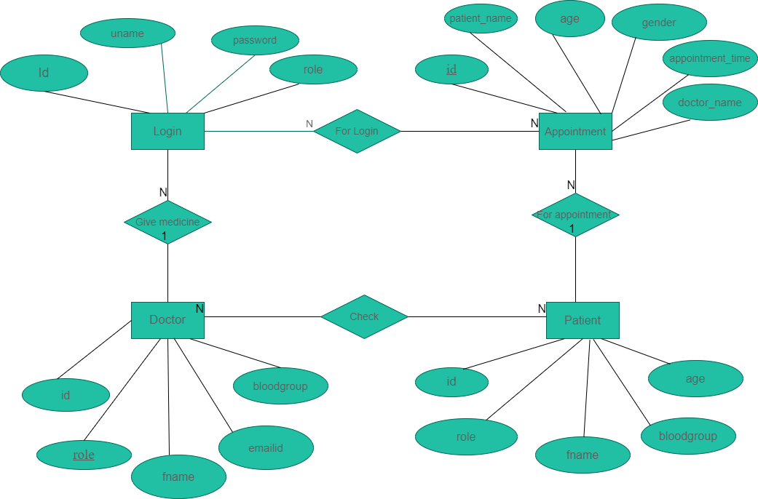
ENTITY-RELATIONSHIP DIAGRAM

Slide 12
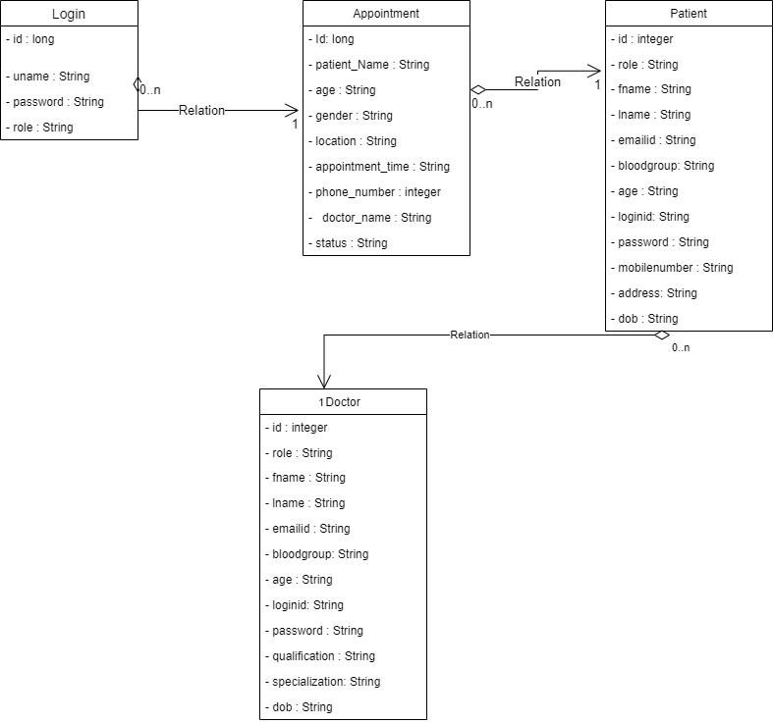
CLASS DIAGRAM

Slide 13
Conclusion
Since this is the “ Hospital Management System ” project so basically the project Hospital Management System (HMS) is for computerizing the working in a hospital. The software takes care of all the requirements of an average hospital and is capable to provide easy and effective storage of information related to patients that come up to the hospital.

Slide 14
THANK YOU
A big thank to Edubridge for providing us this course via which we got a lot of things to learn.
A special thank to our trainer POOJA MEHTA ma’am & SIPIKA SAINI ma’am for teaching us the course in such a way that it became very useful to us.
Once again a special thank to POOJA MEHTA ma’am for helping us in our project by solving our errors , doubts and results.

